Slide 1

WRITING THE
INCIDENT
STORY
$ ./hunt --hypothesis clickfix && ./write --report
David Pérez
Threat Intelligence & Threat Hunting
DEATHCON 2026 · WORKSHOP · NOVEMBER 13–14
Notes:
Welcome. This workshop has one goal: that you leave knowing how to write a threat hunting report someone can act on. To get there we hunt for real: a ClickFix hypothesis, seed queries in Microsoft Sentinel and telemetry seeded in the lab. The finding is the raw material; the report is the deliverable.

Slide 2
The workshop in one hour
OPENING
01
Opening
3 min
02
Why the report matters
5 min
03
Threat hunting in ten minutes
10 min
04
The ClickFix case: from the lure to the only alert
10 min
05
The hunt in Microsoft Sentinel
12 min
06
Writing the story
15 min · the heart of the workshop
07
Your turn: the exercise
5 min
WRITING THE INCIDENT STORY · DEATHCON 2026
2
Notes:
The order matters: first we hunt so we have something to tell, then we learn how to tell it. Most of the time goes to block 6. All the material (queries, template, exercise and rubric) is in the repo, so there is no need to copy anything from the slides.

Slide 3
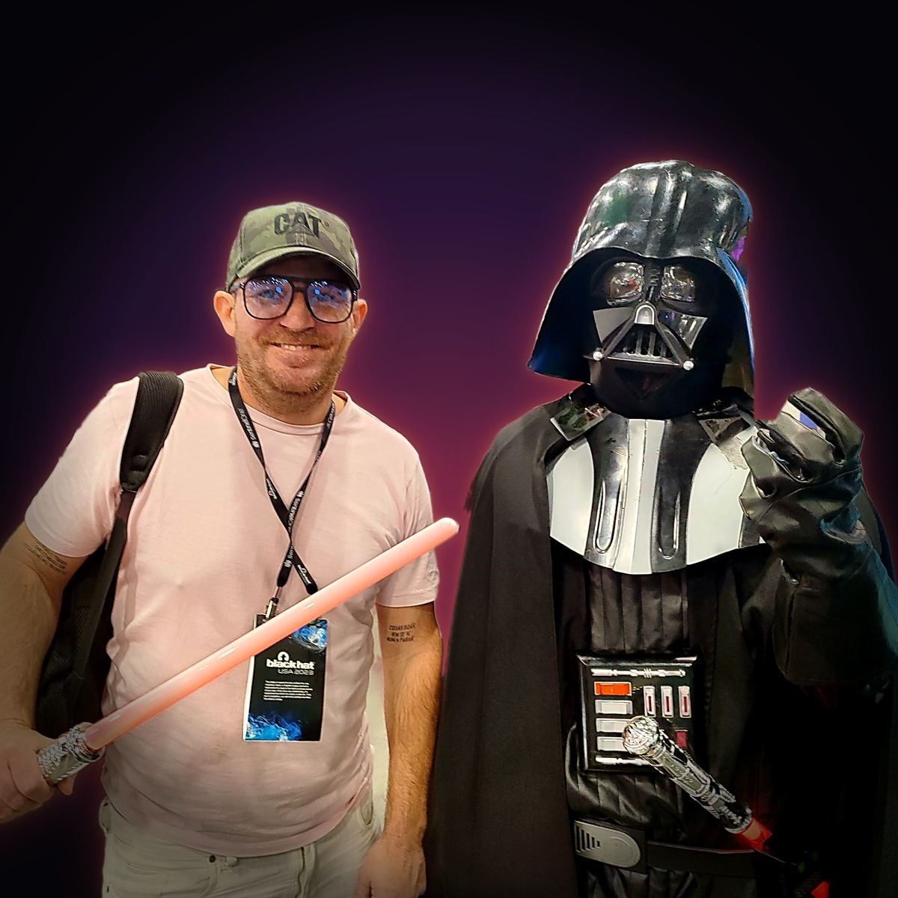
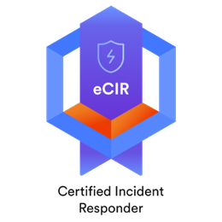





Who am I?
OPENING
CAREER
SOC Analyst (L1, L2) → Phishing Analyst → Threat Intelligence, Threat Hunter and Incident Response. Today, SOC and IR lead.
GOVERNMENT
Criminal intelligence (Information Collection Area) and Analysis and Counterintelligence Dept., Ministry of Justice of Buenos Aires.
TOPICS I FOLLOW
Threat intelligence, ransomware, the initial access ecosystem and leaks in LATAM.
CERTIFICATIONS
eCIR · eCTHP (INE Security) · CTIA · ECIH (EC-Council) · CCFA (CrowdStrike) · SC-200 (Microsoft) · CC (ISC²)
David Pérez · Anakin
@anakinswal · github.com/Ank1nskywalker/talks · perez.edav@gmail.com
CONTACT
Threat Intelligence & Threat Hunting
WRITING THE INCIDENT STORY · DEATHCON 2026
3
Notes:
A quick introduction. What matters for this workshop: I come from intelligence analysis, where a badly written report is a report nobody uses. That discipline (separating facts from assessments, saying how sure you are) is what we are bringing into threat hunting.

Slide 4
A hunt without a report never happened.
WHY WE ARE HERE
The query gets lost. The report stays.
WRITING THE INCIDENT STORY · DEATHCON 2026
4
Notes:
The central idea of the workshop. You can find the most interesting intrusion of the year: if you don’t write it up so someone else can understand and use it, for the organization it never happened. The query stays in your history; the report is what gets approved, audited and inherited.

Slide 5




Who reads your report?
WHY THE REPORT MATTERS
The decision-maker
The SOC
The next hunter
The auditor
Management or CISO
Analysts and detection engineering
Whoever repeats the hunt in six months
Client or compliance
What happened, what the risk is and what they need to approve. Reads one page.
Proof that you looked, even if nothing was found.
The queries, the IOCs and the rules that remain.
What was searched, how, and what could not be seen.
Write for the decision-maker; document for the other three.
WRITING THE INCIDENT STORY · DEATHCON 2026
5
Notes:
One report has four readers with different needs. The most common mistake is writing only for the SOC: queries and screenshots with no conclusion. The decision-maker reads the executive summary and nothing else; everything else lives in the appendices. That is why the order of the report matters as much as its content.

Slide 6
A report answers three questions, whether you find something or not
WHY THE REPORT MATTERS
What happened?
What didn’t we see?
What changes tomorrow?
Findings with a verdict and evidence.
Scope, limitations and confidence level.
Detections, actions with an owner and the next hypothesis.
→ Findings and executive summary
→ Scope and limitations
→ Recommendations and action plan
WRITING THE INCIDENT STORY · DEATHCON 2026
6
Notes:
These three questions are the skeleton of the report, and they still apply when the hunt finds nothing. The second one is the most often skipped: what you could not see is information for the decision-maker, because it tells them how much to trust the rest.

Slide 7
What threat hunting is not
THREAT HUNTING IN TEN MINUTES
Not waiting for the alert
Not triage
Not sweeping IOCs
Not incident response
Working the SIEM queue is necessary, but those are alerts someone already wrote.
Searching a feed’s hashes is useful, short-lived and needs no hypothesis.
If you start when the alarm goes off, you are responding, not hunting.
IR starts from a certainty: something happened. Hunting starts from a doubt.
Threat hunting is the proactive, iterative search for threats that evaded existing controls.
Assume breach · Start from a hypothesis · End with something new
Source: Sqrrl, “A Framework for Cyber Threat Hunting” · Bianco et al., PEAK (Splunk SURGe, 2023)
7
Notes:
Before defining it, let’s clear up the confusion. The four things above are necessary in a SOC, but none of them is hunting. The definition has three parts we will see in the case: we assume something got past the controls, we start from a concrete question and we finish with something we did not have before (a detection, visibility or containment).

Slide 8
Three ways to hunt
THREAT HUNTING IN TEN MINUTES
TODAY’S
ATT&CK
EXPLORATORY
Intelligence-driven
Hypothesis-driven
Baseline
Starts from outside. A report, a feed or a PIR tells you what is happening, and you translate its TTPs, not its IOCs, into a question for your fleet.
Starts from an idea, with no report to trigger it: you start from ATT&CK or your own experience. “If the adversary did X, I would see it in Y.”
Starts from the data. You define normal and hunt the odd: stack counting, rarity across the fleet, things seen only once.
Example: ClickFix was 47% of initial access. Did anyone in the fleet paste a command?
Example: if someone persists in the browser, a process that is not Chrome will write its profile.
Example: how many times a month does csc.exe run with no arguments across 3,000 hosts?
Adapted from PEAK (Bianco et al., Splunk SURGe, 2023)
8
Notes:
All three are valid and they combine. Today we use the first: an intelligence data point (ClickFix dominates initial access) becomes a question the telemetry can answer. The key is translating TTPs, not IOCs: the IOCs in a report are already dead by the time you read it.

Slide 9
The Pyramid of Pain
THREAT HUNTING IN TEN MINUTES
TTPs · Tough!
In this case
Tools · Challenging
Hash · trivial
The script’s hash changed on every download.
Network/Host Artifacts · Annoying
Domain · simple
Domain Names · Simple
The stage-1 domain no longer resolved days after we captured it.
IP Addresses · Easy
TTP · tough
Hash Values · Trivial
The behavior did not change: paste, hide the console, inject into .NET and persist in the browser.
Source: D. J. Bianco, “The Pyramid of Pain” (2013)
9
Notes:
The higher you detect, the more it costs the attacker to change. We saw it while preparing this workshop: the stage-1 domain stopped resolving within days and the script changed its hash on every download. The only stable thing was the behavior. That is why the hypothesis is written at the TTP level.

Slide 10
The hunt cycle
THREAT HUNTING IN TEN MINUTES
PREPARE
EXECUTE
ACT
1
2
3
4
5
Hypothesis
Data
Query
Analysis
Report
What would the adversary do, and where would I see it?
Do I have the telemetry? What can’t I see?
Does it find what I know exists?
Malicious, benign or inconclusive?
What changes tomorrow?
In the case
In the case
In the case
In the case
In the case
Tested against a positive control.
Every result, with its verdict.
Detections, gaps and the next hypothesis.
A user pasted a ClickFix command.
Processes, network, files and registry. Not the clipboard.
↺ The report feeds step 1: every hunt leaves the next hypothesis.
Prepare / Execute / Act phases of the PEAK framework (Splunk SURGe, 2023)
10
Notes:
Five steps in three phases. Notice that the report is a step in the cycle, not paperwork at the end: it is what turns a hunt into a detection, a documented gap or a new hypothesis. In the case, the browser extension we found gave us the next hunt.

Slide 11
ClickFix: why it is the hypothesis
THE CLICKFIX CASE
47%
+517%
4 in 5
17,000+
of the initial access cases seen by Microsoft Defender Experts were ClickFix. Phishing: 35%.
between H2 2024 and H1 2025: the second vector, behind phishing.
payloads intercepted in 2026 arrived from a search engine, not from email.
URLs with fake verification pages analyzed; about 3,000 active.
Microsoft, DDR 2025
ESET, H1 2025
Push Security, 2026
CTM360, Sep 2026
HOW IT WORKS
1 · You search
2 · A fake error
3 · It copies a command
4 · Paste and Enter
Music, software, a “fix”.
A CAPTCHA, “verify you are human”.
The victim runs it. No attachment, no exploit.
The page leaves it on the clipboard.
Sources: Microsoft DDR 2025 · ESET Threat Report H1 2025 · Push Security (2026) · CTM360 (Sep 2026)
11
Notes:
Why ClickFix and not something else: it is the leading initial access vector of the past year and it arrives through search engines, so the email gateway never sees it. The EDR does record it, but as user activity, with Microsoft-signed binaries and informational risk. That is exactly the kind of thing you have to go looking for.

Slide 12
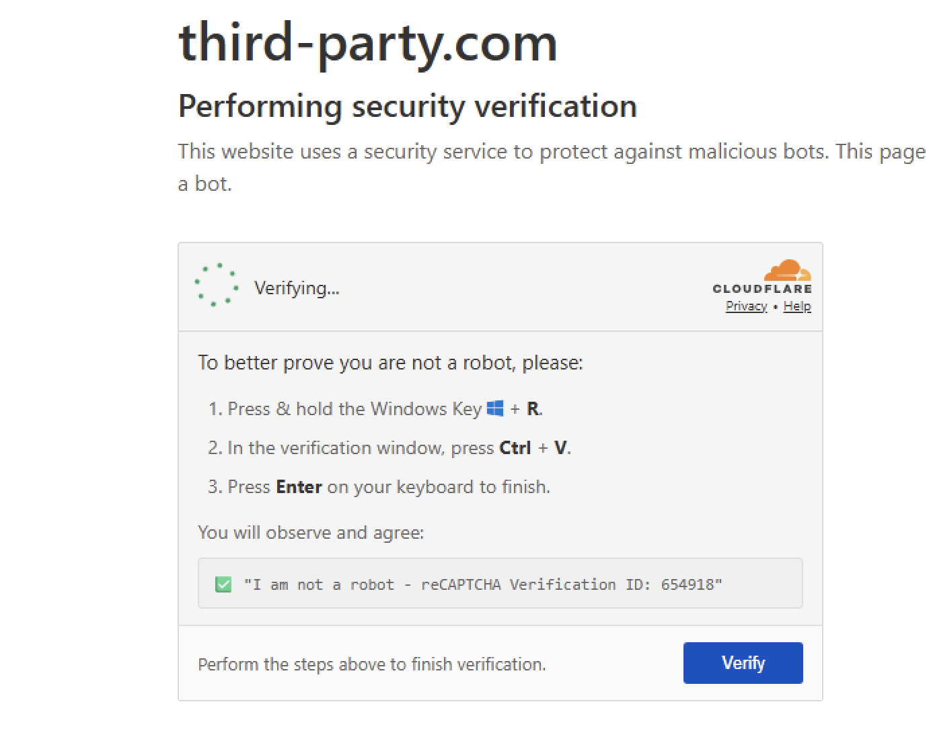
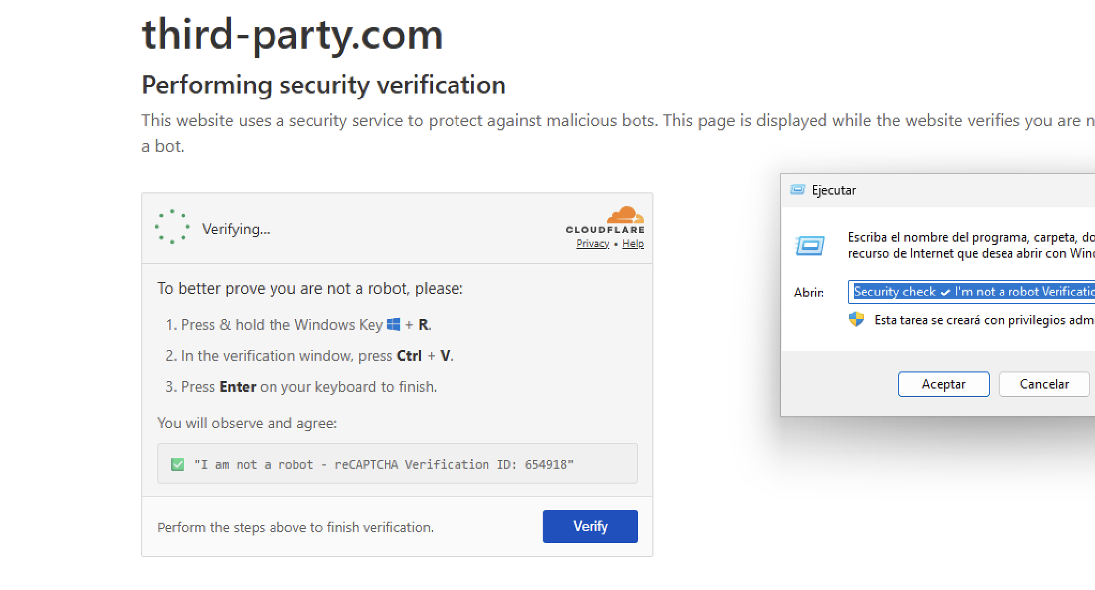
The lure: Win+R, Ctrl+V, Enter
THE CLICKFIX CASE
The “Verification ID” is the disguise: what the victim pastes is a command.
third-party[.]com, captured on 2026-10-12 in our own sandbox. The clipboard is not logged: telemetry sees the paste, never the page.
WRITING THE INCIDENT STORY · DEATHCON 2026
12
Notes:
This is what the victim sees. The fake page copies the command to the clipboard and gives three instructions. What appears in the Run dialog looks like a verification code, but the start of the line is PowerShell. Key point for the report: the clipboard leaves no trace, so the paste has to be shown with indirect evidence. We will see how with ACH.

Slide 13
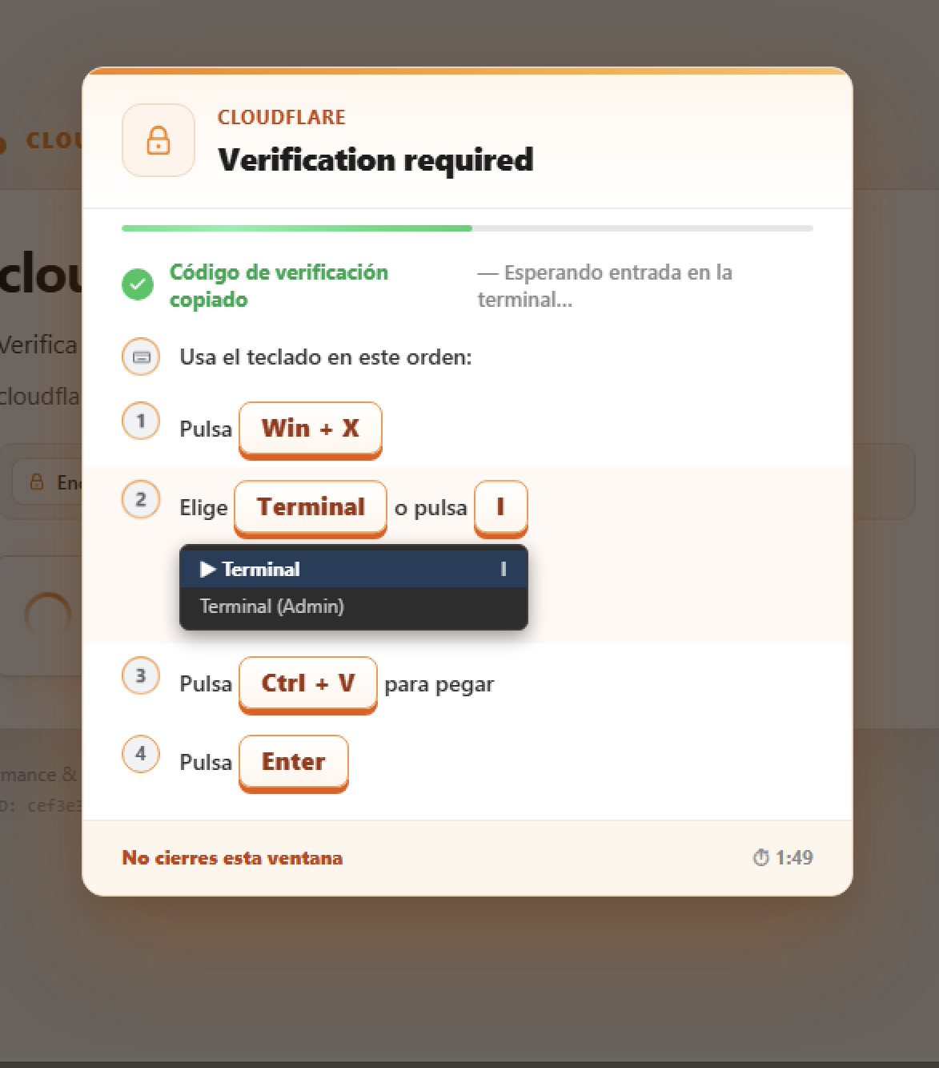
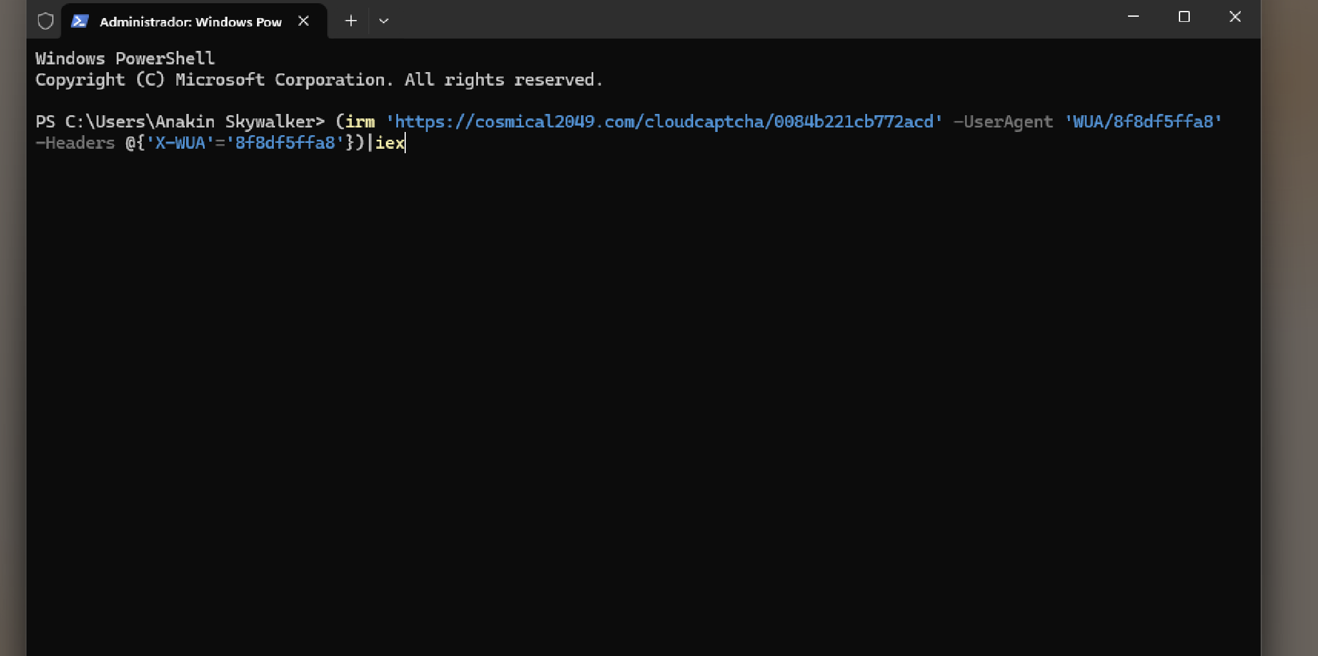
The variant: Win+X → Terminal
THE CLICKFIX CASE
Win+X → Terminal skips the Run dialog: nothing lands in RunMRU and, if the command runs inside PowerShell, not as a command line either.
cloudflare[.]vc, 2026-10-12. The command fetches stage 1 from cosmical2049[.]com and only works with the right User-Agent and X-WUA header.
WRITING THE INCIDENT STORY · DEATHCON 2026
13
Notes:
The same campaign, days later, no longer asked for Win+R: it asked for Win+X and Terminal. That breaks a detection built only on the RunMRU key, because that key only stores what is typed into the Run dialog. And because the command is pasted into an already open PowerShell, it does not show up as a new process either: Script Block Logging sees it. That is why the hunt combines lineage, RunMRU and 4104: each source covers a gap in another. The infrastructure is public: Muhammad Hasan Ali documented it in his analysis of the campaign.

Slide 14
The reality: the alert came at step 7
THE CLICKFIX CASE
T+0:00
Pastes the command
PowerShell downloads a script from an IP written in decimal notation.
INFO
T+0:03
Hidden console
The window disappears: the user thinks it failed and retries.
INFO
T+0:05
Silent MSI
An installer from %TEMP%, with no windows.
INFO
T+0:07
Hidden PowerShell
Launched by the installer itself (msiexec).
INFO
T+0:22
Persistence
An injected .NET binary registers a fake Chrome extension.
INFO
T+0:26
C2 connection
Another .NET binary goes out over HTTP. The IP was on a reputation list.
BLOCKED
T+4:51
The alert
Reaches the SOC console.
ALERT
The only thing that alerted was a known IOC. Everything else was in the telemetry as “info”.
Times relative to the first paste, per EDR telemetry. Victim data anonymized.
14
Notes:
This is the timeline of the real case behind the model report. Five steps were recorded as informational, with no alert. The alert arrived almost five minutes later, and only because one of the attacker’s three IPs was on a list. Had that IP not been listed, the attack would have generated no alert at all. That blind window is the case for hunting.

Slide 15
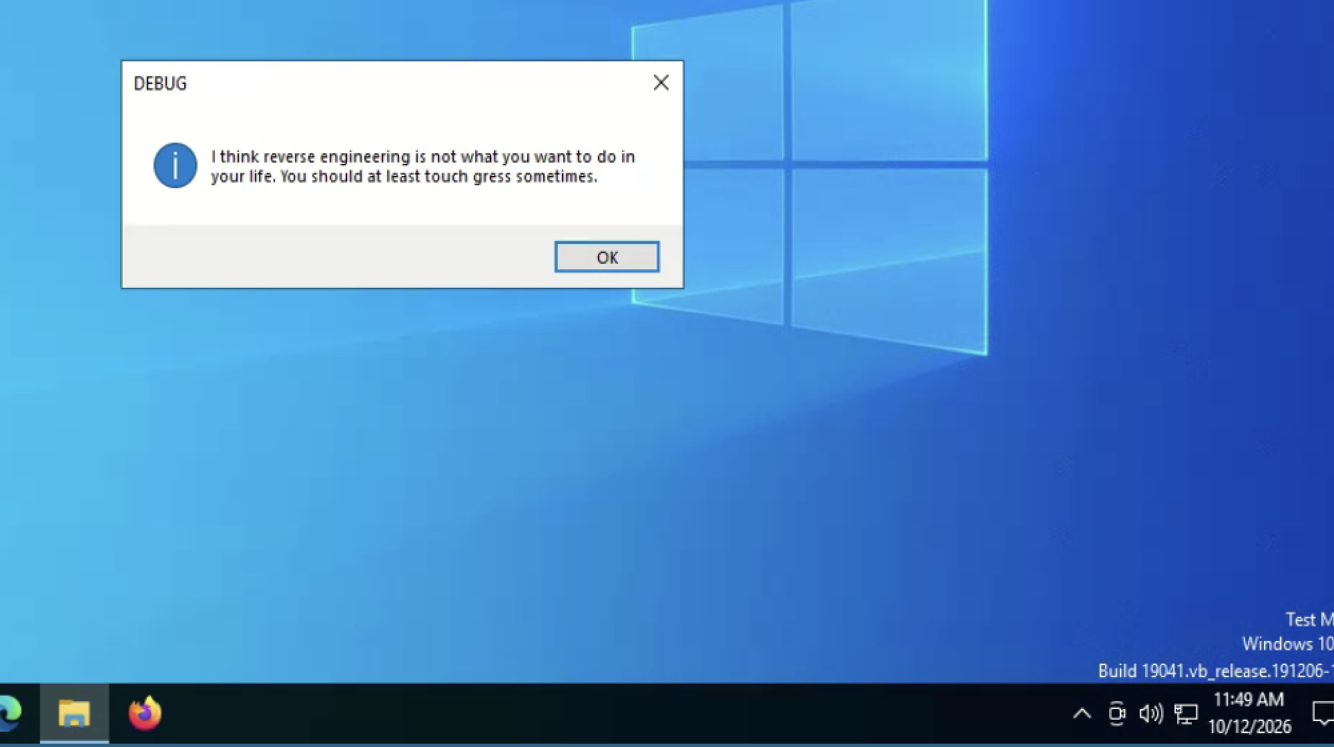

The sandbox said: “No threats detected”
THE CLICKFIX CASE
ANY.RUN verdict on stage 1
No threats detected
BUT THE BEHAVIOR SAID OTHERWISE
Changes the AMSI initialization state · T1562.001
Sets ServicePointManager.SecurityProtocol · T1071
Converts values to bytes to decode · T1027
Two layers of evasion. The server only delivers with the right User-Agent, header and a token that, in our tests, did not work twice. The payload checks its environment and refuses to run if it detects analysis.
What the payload showed in the sandbox: a message for the analyst, not the chain.
A clean verdict is not the absence of a threat: it can be successful evasion.
Our own ANY.RUN detonation, 2026-10-12 · Sigma rules generated by the sandbox
15
Notes:
We detonated it in ANY.RUN while preparing the workshop. The verdict was clean, but the three behavior rules fired: it is the classic preamble of a loader. On the second run the payload detected the environment and showed a mocking message instead of executing. For the report this is gold: it proves why the verdict alone is not enough, and it is a limitation you have to declare.

Slide 16
The exercise hypothesis
THE HUNT IN SENTINEL
If someone pasted a command from a ClickFix lure, we will see an interpreter launched by Explorer (Win+R) or by the browser (FileFix) with a download command and, seconds later, the chain that command triggers.
Data source | EDR processes, network, files and registry across the fleet: the events, not the alerts.
Positive control | Reproduce the pattern on a lab host and confirm the query finds it.
Confirmed by | A host with an interpreter that downloads and executes, followed by the chain it launches.
Refuted by | Zero results, with the query already validated against the positive control.
Known gap | The clipboard is not logged. RunMRU only sees Win+R; a paste into Terminal (Win+X) is only seen by Script Block Logging.
ATT&CK | T1204.004 → T1059.001 · T1564.003 · T1218.007 · T1055 · T1176.001
WRITING THE INCIDENT STORY · DEATHCON 2026
16
Notes:
The hypothesis is written so the data can confirm or refute it, which is why we define up front what confirms it, what refutes it and what we will not be able to see. This table goes straight into the report: it is the hypothesis section of the template. Notice that the known gap is written before hunting, not as an excuse afterwards.

Slide 17
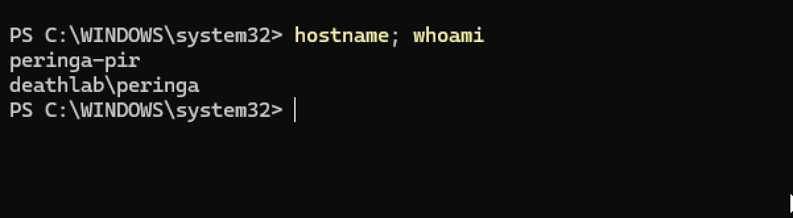
Zero results without a positive control prove nothing
THE HUNT IN SENTINEL
While preparing this workshop, nine queries in a row came back empty. This is how we diagnosed it:
1
Does the table have data?
Yes: four hosts with registry events.
2
Is my test event there?
The positive control ran on the instructor workstation, which sends no telemetry. The query was fine; the host was not.
No.
3
Which accounts create processes on that host?
Other instructors’. Not mine.
4
Is the test host in DeviceInfo?
No: it had no Defender sensor.
Before concluding “it’s not there”, prove the query finds what you know exists — on the right host.
WRITING THE INCIDENT STORY · DEATHCON 2026
17
Notes:
This really happened while preparing the lab, and it is the best lesson of the workshop. Had we written the report from those nine empty queries, we would have concluded there was nothing there, or that the platform does not capture the event. Both conclusions would have been false. The positive control is not a formality: it is what separates “there is nothing” from “I am not looking right”.

Slide 18
Seven chained queries
THE HUNT IN SENTINEL
# | Question | What it looks for | Table
1 | Did anyone paste a command? | Explorer or the browser launches an interpreter with a download command | DeviceProcessEvents
2 | Why didn’t they see it? | A Start-Process with -WindowStyle Hidden and the rest of the script’s cmdlets | DeviceEvents · PowerShellCommand *
3 | What came next? | msiexec launches a hidden PowerShell | DeviceProcessEvents
4 | Who did it talk to? | A .NET binary (csc, ilasm) with an outbound connection | DeviceNetworkEvents
5 | Did it locate itself? | A non-browser process checks its public IP | DeviceNetworkEvents
6 | How does it stay? | A non-browser process modifies the Chrome profile | DeviceFileEvents
7 | Next hunt | A manifest.json created outside the browser | DeviceFileEvents
Full queries in the workshop repo · * the lab doesn’t ingest 4104: PowerShellCommand shows the cmdlets, not the script
18
Notes:
The queries are not run in isolation: each result raises the next question. If the first one finds a host, the second explains why the user retried, the third shows what was installed, and so on up to persistence. The seventh is planned: it is the new hypothesis this hunt leaves behind. They are all in the repo, ready to paste into Sentinel.

Slide 19
Query 1: the lineage of the paste
THE HUNT IN SENTINEL
Why the browser
DeviceProcessEvents
FileFix runs the command from the browser’s file dialog: the parent is chrome.exe or msedge.exe.
| where TimeGenerated > ago(30d)
| where FileName in~ ("powershell.exe", "pwsh.exe",
"cmd.exe", "mshta.exe")
| where InitiatingProcessFileName in~ ("explorer.exe",
What it does not see
"chrome.exe", "msedge.exe", "firefox.exe")
A paste into an already open console (Win+X → Terminal): the parent is the console and, in PowerShell, the command is not even a command line. Script Block Logging sees it.
| where ProcessCommandLine has_any ("irm", "iwr", "iex",
"Invoke-RestMethod", "Invoke-WebRequest",
"DownloadString", "http")
| project TimeGenerated, DeviceName, AccountName,
InitiatingProcessFileName, ProcessCommandLine
Validated in the lab
| sort by TimeGenerated asc
On Windows 11 the parent is explorer.exe, and RunMRU stores the full command.
WRITING THE INCIDENT STORY · DEATHCON 2026
19
Notes:
This is the seed query that opens the hunt. It looks for interpreters launched by Explorer (Win+R) or by the browser (FileFix) with something that smells like a download. It is deliberately broad: it will bring back noise, and classifying it is part of the exercise; the PowerShell the sensor itself launches stays out because its parent is SenseIR. What it does not see is a paste into an already open console, like the Win+X Terminal variant: there the command runs inside an interactive PowerShell and only Script Block Logging records it. Before using it, run the positive control on a lab host that sends telemetry.

Slide 20
Noise is part of the story too
THE HUNT IN SENTINEL
What you see | What it is | What to do
PowerShell -ExecutionPolicy AllSigned -NoProfile, launched by SenseIR.exe | The Defender sensor itself | Exclude by parent process
powershell -File …\SYSVOL\…\Invoke-WEFClientSetup.ps1 with -encodedCommand | A Windows Event Forwarding GPO | Exclude by SYSVOL path, documented
DownloadFile from http://127.0.0.1/1.exe to invoice.exe | Another lab instructor’s simulation | Inconclusive: ask, don’t assume
mscopilot.exe and msedgewebview2.exe write Preferences | Copilot and WebView2 in their own profile | Justified exclusion in the rule
Document every false positive with its justification: that is what makes a detection reusable.
Rows 1–3: seen in the DEATHCon lab · row 4: model report case
20
Notes:
We really found the first three rows in the lab while running the queries. They all look malicious at first glance: PowerShell with bypass, encoded commands, downloads. None of them is. The lab is shared, so you will see activity from other workshops: classify it, do not ignore it. A well-documented false positive is an exclusion the next analyst does not have to investigate again.

Slide 21
From loose findings to a story
WRITING THE STORY
The hunt is done. Now tell it so someone can use it.
WRITING THE INCIDENT STORY · DEATHCON 2026
21
Notes:
New block. So far we have findings: query results, screenshots, a timeline. That is not a report yet. In this block we cover the structure, how to write the executive summary, how to separate facts from assessments and how to say how sure you are.

Slide 22
The structure of the report
WRITING THE STORY
1
Executive summary
6
Methodology
What happened and what needs deciding, on one page.
PEAK and how the queries were chained.
2
Hunting hypothesis
7
Findings
The question, and what confirms or refutes it.
Verdict and evidence per query.
3
Scope and limitations
8
Recommendations
What was examined, what could not be seen, and with what confidence.
Actions with a priority, an owner and a status.
4
Background
9
Conclusion
The intelligence behind the hypothesis, with sources.
The whole story in one paragraph.
5
MITRE ATT&CK
10
Appendices
Technique, tactic and evidence in the case.
IOCs, queries, timeline, controls and sources.
Full template in English and Spanish: github.com/Ank1nskywalker/Templates
22
Notes:
Ten sections, in this order. The order is not cosmetic: it runs from what the decision-maker needs (at the top) to what whoever repeats the hunt needs (the appendices). The executive summary is highlighted because it is the only thing many readers will read, and it is what we look at next.

Slide 23
Executive summary: first things first
WRITING THE STORY · BLUF
BEFORE · EXAMPLE
AFTER · MODEL REPORT
In September several queries were run in the EDR and suspicious PowerShell-related activity was observed on some hosts, which could be linked to ClickFix. Further investigation is recommended.
Hypothesis confirmed on one host (XXXX-01). A user pasted a command from a ClickFix lure into Win+R and, in under 30 seconds, a session-stealing Chrome extension was installed. The only alert arrived at T+4:51.
The verdict in the first line
Written for someone who doesn’t read KQL
Numbers, not adjectives
WRITING THE INCIDENT STORY · DEATHCON 2026
23
Notes:
BLUF: bottom line up front. The version on the left is not badly written, but it says nothing: no verdict, no scope, no impact, and it ends by asking for more work. The one on the right makes sense without knowing what KQL is: what happened, where, how long it took and why it matters. If the decision-maker only reads the first paragraph, they already have what they need.

Slide 24
Facts and assessments, kept apart
WRITING THE STORY
Fact · what the telemetry shows | Assessment · what we infer
csc.exe ran with no arguments and modified Secure Preferences. | Likely: code injected into a signed .NET binary.
explorer.exe wrote the same command to RunMRU four times. | Very likely: the user retried because the script hid the console.
Only one of the three C2s was on a reputation list, and it was the only one blocked. | Very likely: without a block, the other two are still reachable from the network.
A fact takes a past-tense verb and its source. An assessment takes a probability word and the reason why.
If the reader can’t tell what you saw from what you think, they can’t trust either.
WRITING THE INCIDENT STORY · DEATHCON 2026
24
Notes:
The most expensive mistake in a report is mixing what you observed with what you inferred. “The injected csc.exe modified the profile” sounds like a fact, but the injection is an assessment: what you saw is a csc.exe with no arguments writing a Chrome file. Write them in separate sentences. That way, if new evidence shows up tomorrow, the assessment gets revised and the fact still stands.

Slide 25
Say how sure you are
WRITING THE STORY
PROBABILITY · ICD 203
SOURCES · ADMIRALTY CODE
Almost no chance
01–05 %
Source reliability
Information credibility
Very unlikely
05–20 %
A · Completely reliable
1 · Confirmed
Unlikely
20–45 %
B · Usually reliable
2 · Probably true
C · Fairly reliable
3 · Possibly true
Roughly even chance
45–55 %
D · Not usually reliable
4 · Doubtful
Likely
55–80 %
E · Unreliable
5 · Improbable
Very likely
80–95 %
F · Cannot be judged
6 · Cannot be judged
Almost certain
95–99 %
Confidence high, moderate or low: how solid the evidence is, not how likely the event is.
In the report: “High confidence that XXXX-01 was compromised: registry, process, network, file and sandbox evidence agree. Moderate confidence that no other hosts are affected: the main query only covers Win+R.”
Sources: ODNI, Intelligence Community Directive 203 · NATO / Admiralty grading system
25
Notes:
Two intelligence tools that threat hunting rarely adopts. With ICD 203, “likely” stops being an opinion and becomes a range the reader can understand. Confidence is something else: it says how much independent evidence you have. With Admiralty you grade each intelligence source you cite: a vendor report with a good track record might be B2. Apply it per finding, not once for the whole report.

Slide 26
Competing hypotheses: was it pasted?
WRITING THE STORY · ACH
Evidence | H1 · Pasted | H2 · Typed | H3 · Remote
Recorded in RunMRU, written by explorer.exe | Consistent | Consistent | Inconsistent
120 characters with a decimal IP, in seconds | Consistent | Inconsistent | Neutral
The same command, identical, four times | Consistent | Inconsistent | Consistent
No remote access tools in 24 h | Neutral | Neutral | Inconsistent
The browser visited a lure seconds earlier | Consistent | Neutral | Neutral
H1: pasted from a lure · H2: typed by hand · H3: launched by another process or a remote session
H1 is the only one with no evidence against it. ACH doesn’t count support: it keeps the hypothesis that survives.
Method: R. J. Heuer, “Psychology of Intelligence Analysis” (CIA, 1999) · example based on the model report case
26
Notes:
The clipboard is not logged, so you will never have direct proof that the command was pasted. ACH forces you to list the possible explanations and look for the evidence that contradicts them, not the evidence that supports them. What matters in the report is this table: it shows why you discarded the alternatives, and it lets another analyst challenge your conclusion with the same data.

Slide 27




A hunt with no findings still gets reported
WRITING THE STORY
Zero results is a result, if you can prove the query works.
Coverage
Positive control
Gaps
Next hypothesis
Which hosts, which time window and which data sources.
The evidence that the query finds the pattern you were looking for.
What could not be seen: the clipboard, a channel with no telemetry, a source not ingested.
What you would look for if you had the missing visibility.
A report like this tells the decision-maker how much to trust the silence.
WRITING THE INCIDENT STORY · DEATHCON 2026
27
Notes:
Most hunts find nothing, and that is normal. The mistake is not writing them up, or writing only “no indicators were found”. Without coverage and a positive control, that silence is worth nothing. With them, it is evidence that a technique is not happening in your fleet, and the list of gaps tells the organization where to invest in visibility.

Slide 28






Before you hand it in
WRITING THE STORY · CHECKLIST
The executive summary fits on one page and opens with the verdict.
Every recommendation has a priority, an owner and a status.
Every finding has a verdict, evidence and a confidence level.
The queries in the appendix can be re-run as they are.
Facts are kept apart from assessments.
The victim’s data is anonymized.
Limitations and gaps are written down, not implied.
The TLP is marked on the cover.
This is the rubric the exercise is graded against.
WRITING THE INCIDENT STORY · DEATHCON 2026
28
Notes:
Eight checks before sending a report. They are not about style: each one answers one of the readers we saw at the start. This list is the rubric for the exercise, so use it to review your own report before sharing it on Discord.

Slide 29
Your turn
THE EXERCISE
1
Log in to the workshop’s Microsoft Sentinel lab.
WORKSHOP REPO
2
Run the seed queries from the repo in order, starting with the positive control.
github.com/Ank1nskywalker/talks, folder 2026
3
Classify every result: malicious, benign or inconclusive.
TEMPLATE EN / ES
github.com/Ank1nskywalker/Templates
4
Write the report with the template. The executive summary goes first.
HINT
The lab is shared: scope by host and time window before you conclude.
5
Share it on Discord and review it against the rubric.
WRITING THE INCIDENT STORY · DEATHCON 2026
29
Notes:
Now it is your turn. The repo README has the step-by-step guide, the queries ready to copy and the brief. You don’t need to find everything: an honest report about what you found and what you could not see is worth more than a list of screenshots. Share it on Discord and we will give you feedback with the same rubric you just saw.

Slide 30
Thank you
Every hunt leaves the next one behind.
Workshop: github.com/Ank1nskywalker/talks
Template: github.com/Ank1nskywalker/Templates
The campaign: M. H. Ali, “Arabic Streaming Websites ClickFix Campaign” (Oct 2026)
Frameworks: PEAK (Splunk SURGe, 2023) · Pyramid of Pain (Bianco, 2013) · ICD 203 (ODNI)
@anakinswal
DEATHCON 2026 · WRITING THE INCIDENT STORY
Notes:
Closing. What you take away: a hunt without a report never happened, the positive control separates “there is nothing” from “I am not looking properly”, and a good report keeps facts apart from assessments and says how sure you are. All the material stays in the repo. See you on Discord.

